Slide 1

Introduction to Mobile Development with Sencha Touch
Sovattha SOK
17.10.2013

Slide 2


Sponsors
www.ctp.com
www.myteamworks.com

Slide 3
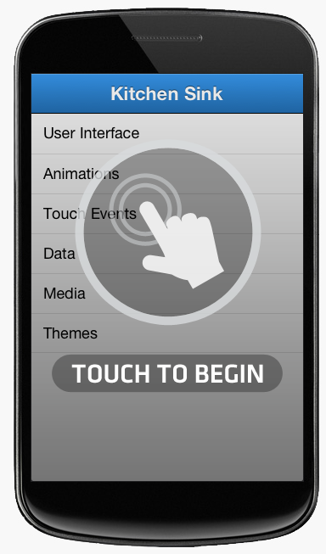
Sencha Touch?
HTML5 mobile application framework
Based on the famous ExtJS
Own Javascript class system
Components
Libraries
Tools
Notes:
Sencha Touch is an MVC JavaScript framework specially designed to create mobile web
applications for touchscreen devices.
Sencha Touch tries to simplify and hide the quirkiest parts of JavaScript by providing
its own class system

Slide 4
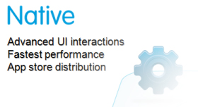
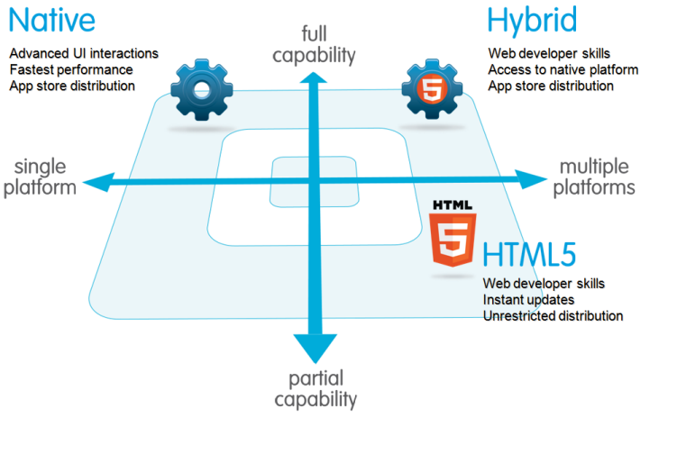
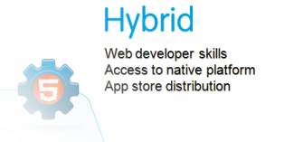



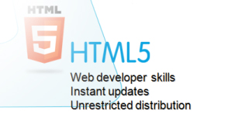

HTML5 mobile application framework

Slide 5
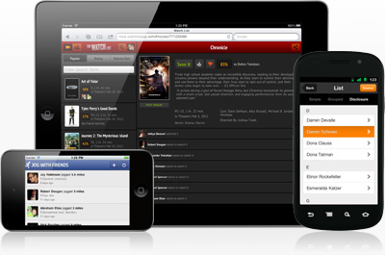
Targets
iOS, Android, Blackberry, Windows Phone
Smartphones, tablets
Desktop web browsers

Slide 6
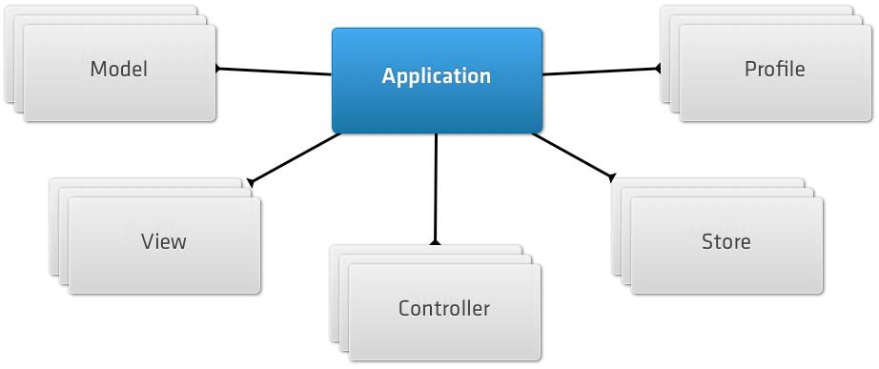
High level components

Slide 7
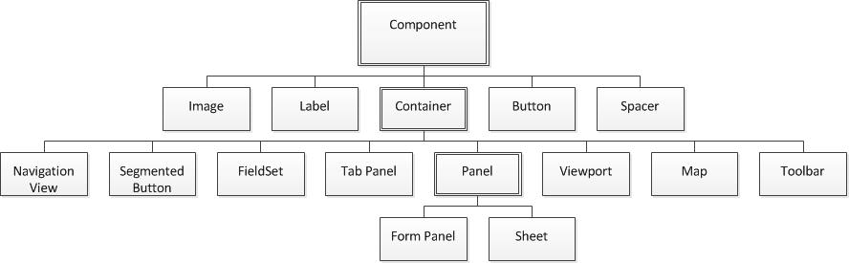
Views
Events
Layouts
Templates

Slide 8
Models
Model classes
Field types
Associations
Validations
Stores and proxies
Local
Remote
Data-bound controls
Dataview
Lists
Notes:
• Stores are abstractions over arrays of model instances; data-bound components
connect to stores to display lists or trees of data, delegating the sorting, ordering,
and grouping of the data to the store. Data-bound views are tied to stores in such
a way that any change to the data of the store will be updated automatically on the
UI.
• Proxies are abstract entities that encapsulate the connection to a particular storage
mechanism, either local or remote. Ideally, Sencha Touch applications are completely
oblivious to the fact that the data is stored locally or remotely; stores use
proxies to isolate the rest of the application from the underlying location of the data.

Slide 9
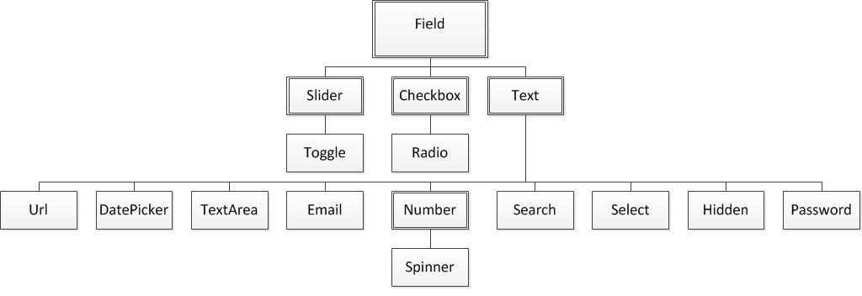
Forms
Form panel
Fieldset
Fields

Slide 10
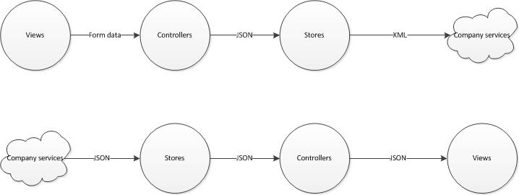
Controllers
Director of the Orchestra

Slide 11
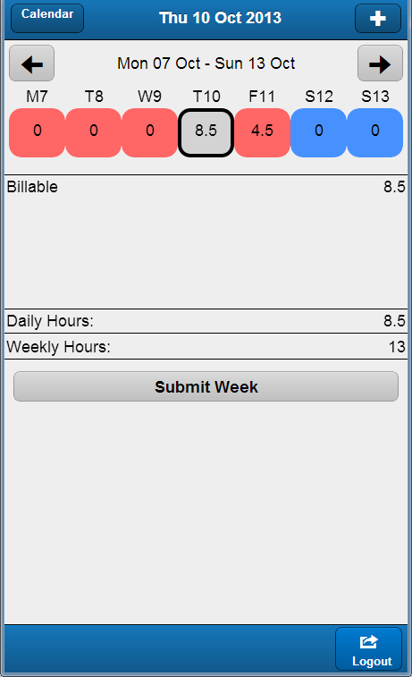
Demo
PPM Everywhere
http://projectopen40.ctp.com:8080

Slide 12
Getting further
Read the API
Learn the tools
Sencha Cmd (Packaging, deploying)
Sencha Architect (IDE)
Siesta (Automated testing)
Links
http://www.sencha.com/products/touch
http://www.bryntum.com/products/siesta/

Slide 13
Conclusion
Pros
High level components
Separation of concerns
Rich documentation
Cons
Steep learning curve
Hard to customize
Rich documentation…
Notes:
• Large UI library widget, largely inspired by iOS, both in design and functionality
• Fast rendering engine based on CSS, which can be hardware-accelerated in the latest
mobile devices
• Well-defined architecture, enforcing the MVC architecture from the very beginning
• Built-in connectors for network data services, such as Representational State Tranfer
(REST) web services, and support for offline mobile web applications
• Advanced class-loading mechanism, enforcing naming guidelines and the MVC
architecture
• A command-line build system, managing merging and minification of application
code, as well as building native applications for Android and iOS
What Is Sencha Touch? | 3
www.it-ebooks.info
• Extensive documentation, available as a set of dynamic HTML pages, including
searching and filtering features without requiring any server-side infrastructure

Slide 14

Q&A

Slide 15
Next session
Introduction to iOS Development with Xamarin
Ricardo Cadima
31.10.2013 – 12:30

Slide 16
USG – We need your help!
We need speakers!
Suggest a topic and share your knowledge with everyone

